Slide 1
Parallel Computer Architecture/Programming Models Shared Memory Models
Introduction to Parallel and Distributed Computing

Slide 2
Learning Outcomes
Define parallelism in hardware and software.
List parallel computer architectures types
Explain different parallel computer architectures.
Define Flynn’s taxonomy.
Define shared memory computers and message passing computers.
List advantages and disadvantages of different parallel computer architectures

Slide 3
Outline
Parallel architecture types
Instruction-level parallelism
Vector processing
Flynn’s Taxonomy
Shared memory
Memory organization: UMA, NUMA
Coherency: CC-UMA, CC-NUMA
Interconnection networks
Distributed memory
Clusters
Clusters of SMPs
Heterogeneous clusters of SMPs

Slide 4
Shared Memory Model
Parallel computers can also be classified according to memory access
Shared Memory Computers
Message Passing (Distributed Memory)
Multi-Processor
Multi-Computer
Cluster
Grid
Cloud

Slide 5
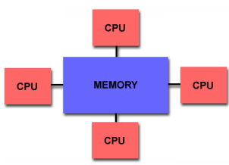
Shared Physical Memory
Add processors to single processor computer system
Processors share computer system resources
Memory, storage, …
Sharing physical memory
Any processor can reference any memory location
Any I/O controller can reference any memory address
Single physical memory address space (Global Address Space)
Changes in a memory location effected by one processor are visible to all other processors
Communication occurs as a result of loads and stores
Two classes of shared memory machines: UMA and NUMA, (and COMA)

Slide 6
Caching in Shared Memory Systems
Reduce average latency
automatic replication closer to processor
Reduce average bandwidth
Data is logically transferred from producer to consumer to memory
store reg → mem
load reg ← mem
Processors can share data efficiently
What happens when store and load are
executed on different processors?
Cache coherence problems
If one processor updates a location in shared memory, all the other processors know about the update. Cache coherence is accomplished at the hardware level
P
P
P

Slide 7
Shared Memory Multiprocessors (SMP)
Architecture types
Differences lie in memory system interconnection
Single processor
Multiple processors
P
P
P
P
P
P
P
P
P
P
M
M
multi-port
M
shared bus
interconnection network
M
I
/
O
d
e
v
i
c
e
s
What does this look like?
M
e
m
M
e
m
M
e
m
M
e
m
I
/
O
c
t
r
l
I
/
O
c
t
r
l
I
n
t
e
r
c
o
n
n
e
c
t
I
n
t
e
r
c
o
n
n
e
c
t
P
r
o
c
e
s
s
o
r
P
r
o
c
e
s
s
o
r

Slide 8
Bus-based SMP
I/O
I/O
Memory bus handles all memory read/write traffic
Processors share bus
Uniform Memory Access (UMA)
Memory (not cache) uniformly equidistant
Take same amount of time (generally) to complete
May have multiple memory modules
Caches introduce memory hierarchy
Lead to data consistency problems
Cache coherency hardware necessary (CC-UMA)
C
C
M
M
$
$
P
P

Slide 9
Crossbar SMP
Replicates memory bus for every processor and I/O controller
Every processor has direct path
UMA SMP architecture
Can still have cache coherency issues
Multi-bank memory or interleaved memory
Advantages
Bandwidth scales linearly (no shared links)
Problems
High incremental cost (cannot afford for many processors)
Use switched multi-stage interconnection network
P
…
P
I/O
C
I/O
C
M
M
M
M

Slide 10
“Dance Hall” SMP and Shared Cache
Interconnection network connects processors to memory
Centralized memory (UMA)
Network determines performance
Continuum from bus to crossbar
Scalable memory bandwidth
Memory is physically separated from processors
Could have cache coherence problems
Shared cache reduces coherence problem and provides fine grained data sharing
M
M
° ° °
M
Network
$
$
° ° °
$
P
P
P
Main memory
(Interleaved)
First-level $
(Interleaved)
Switch
P
1
P
n

Slide 11
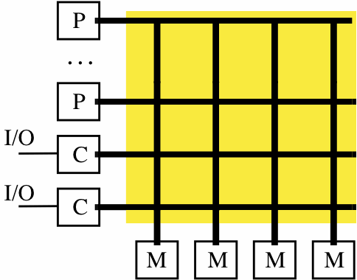
Natural Extensions of the Memory System
P
1
P
n
Scale
Switch
(Interleaved)
P
First-level $
P
1
n
(Interleaved)
$
$
Main memory
Inter
connection network
Shared Cache
Mem
Mem
Centralized Memory
Dance Hall, UMA
P
1
P
n
Mem
$
Mem
$
Inter
connection network
Crossbar, Interleaved
Distributed Memory (NUMA)

Slide 12
Non-Uniform Memory Access (NUMA) SMPs
Distributed memory
Memory is physically resident close to each processor
Memory is still shared
Non-Uniform Memory Access (NUMA)
Local memory and remote memory
Access to local memory is faster, remote memory slower
Access is non-uniform
Performance will depend on data locality
Cache coherency is still an issue (more serious)
Interconnection network architecture is more scalable
Network
M
$
M
$
° ° °
M
$
P
P
P

Slide 13
Cache Coherency and SMPs
Caches play key role in SMP performance
Reduce average data access time
Reduce bandwidth demands placed on shared interconnect
Private processor caches create a problem
Copies of a variable can be present in multiple caches
A write by one processor may not become visible to others
they’ll keep accessing stale value in their caches
⇒ Cache coherence problem
What do we do about it?
Organize the memory hierarchy to make it go away
Detect and take actions to eliminate the problem

Slide 14
Definitions
Memory operation (load, store, read-modify-write, …)
Memory issue is operation presented to memory system
Processor perspective
Write: subsequent reads return the value
Read: subsequent writes cannot affect the value
Coherent memory system
There exists a serial order of memory operations on each location such that
operations issued by a process appear in order issued
value returned by each read is that written by previous write

Slide 15
Motivation for Memory Consistency
Coherence implies that writes to a location become visible to all processors in the same order
But when does a write become visible?
How do we establish orders between a write and a read by different processors?
Use event synchronization
Implement hardware protocol for cache coherency
Protocol will be based on model of memory consistency
P
1
P
2
/* Assume initial value of A and flag is 0 */
A = 1;
while (flag == 0);
/* spin idly */
flag = 1;
print A;

Slide 16
Memory Consistency
Specifies constraints on the order in which memory operations (from any process) can appear to execute with respect to each other
What orders are preserved?
Given a load, constrains the possible values returned by it
Implications for both programmer and system designer
Programmer uses to reason about correctness
System designer can use to constrain how much accesses can be reordered by compiler or hardware
Contract between programmer and system

Slide 17
Sequential Consistency
Total order achieved by interleaving accesses from different processes
Maintains program order
Memory operations (from all processes) appear to issue, execute, and complete atomically with respect to others
As if there was a single memory (no cache)
“A multiprocessor is sequentially consistent if the result of any execution is the same as if the operations of all the processors were executed in some sequential order, and the operations of each individual processor appear in this sequence in the order specified by its program.” [Lamport, 1979]

Slide 18
Sequential Consistency (Sufficient Conditions)
There exist a total order consistent with the memory operations becoming visible in program order
Sufficient Conditions
every process issues memory operations in program order
after write operation is issued, the issuing process waits for write to complete before issuing next memory operation (atomic writes)
after a read is issued, the issuing process waits for the read to complete and for the write whose value is being returned to complete (globally) before issuing its next memory operation
Cache-coherent architectures implement consistency

Slide 19
Bus-based Cache-Coherent (CC) Architecture
Bus Transactions
Single set of wires connect several devices
Bus protocol: arbitration, command/addr, data
Every device observes every transaction
Cache block state transition diagram
FSM specifying how disposition of block changes
invalid, valid, dirty
Snoopy protocol
Basic Choices
Write-through vs Write-back
Invalidate vs. Update

Slide 20
Snoopy Cache-Coherency Protocols
Bus is a broadcast medium
Caches know what they have
Cache controller “snoops” all transactions on shared bus
relevant transaction if for a block its cache contains
take action to ensure coherence
invalidate, update, or supply value
depends on state of the block and the protocol
State
Address
Data

Slide 21
Example: Write-back Invalidate
P
1
P
2
P
3
u
= ?
u
= ?
3
$
4
$
5
$
u
:5
u
:5
u
= 7
1
I/O devices
u
:5
2
Memory

Slide 22
Generic Solution: Directories
Maintain state vector explicitly
associate with memory block
records state of block in each cache
On miss, communicate with directory
determine location of cached copies
determine action to take
conduct protocol to maintain coherence

Slide 23
Requirements of a Cache Coherent System
Provide set of states, state transition diagram, and actions
Manage coherence protocol
(0) Determine when to invoke coherence protocol
(a) Find info about state of block in other caches to
determine action
whether need to communicate with other cached copies
(b) Locate the other copies
(c) Communicate with those copies (inval/update)
(0) is done the same way on all systems
state of the line is maintained in the cache
protocol is invoked if an “access fault” occurs on the line
Different approaches distinguished by (a) to (c)

Slide 24
Bus-base Cache Coherence
All of (a), (b), (c) done through broadcast on bus
faulting processor sends out a “search”
others respond to the search probe and take necessary action
Could do it in scalable network too
Conceptually simple, but broadcast doesn’t scale
on bus, bus bandwidth doesn’t scale
on scalable network, every fault leads to at least p network transactions
Scalable coherence:
can have same cache states and state transition diagram
different mechanisms to manage protocol

Slide 25
Basic Snoop Protocols
Write Invalidate :
Multiple readers, single writer
Write to shared data: an invalidate is sent to all caches
Read Miss:
Write-through: memory is always up-to-date
Write-back: snoop in caches to find most recent copy
Write Broadcast (typically write through):
Write to shared data: broadcast on bus, snoop and update
Write serialization: bus serializes requests!
Write Invalidate versus Broadcast

Slide 26
Snooping Cache Variations
Basic Protocol
Exclusive
Shared
Invalid
Berkeley Protocol
Owned Exclusive
Owned Shared
Shared
Invalid
Illinois Protocol
Private Dirty
Private Clean
Shared
Invalid
MESI Protocol
Modified (private,!=Memory)
Exclusive (private,=Memory)
Shared (shared,=Memory)
Invalid
Owner can update via bus invalidate operation
Owner must write back when replaced in cache
If read sourced from memory, then Private Clean
if read sourced from other cache, then Shared
Can write in cache if held private clean or dirty

Slide 27
Scalable Approach: Directories
Every memory block has associated directory information
keeps track of copies of cached blocks and their states
on a miss, find directory entry, look it up, and communicate only with the nodes that have copies if necessary
in scalable networks, communication with directory and copies is through network transactions
Many alternatives for organizing directory information

Slide 28
Basic Operation of Directory
k processors
Each cache-block in memory
k presence bits and 1 dirty bit
Each cache-block in cache
1 valid bit and 1 dirty (owner) bit
Read from memory
Dirty bit OFF
Dirty bit ON
Write to memory
Dirty bit OFF

Slide 29
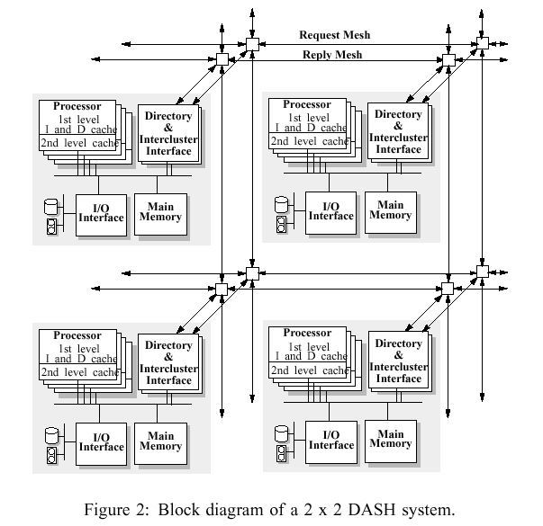
DASH Cache-Coherent SMP
Directory Architecture for Shared Memory
Stanford research project (early 1990s) for studying how to build cache- coherent shared memory architectures
Directory-based cache coherency
D. Lenoski, et al., “The Stanford Dash Multiprocessor,” IEEE Computer, Volume 25 Issue 3, pp: 63-79, March 1992

Slide 30
Sequent NUMA-Q
Ring-based SCI network
1 GB/second
Built-in coherency
Commodity SMPs as building blocks
Extend coherency mechanism
Split transaction bus

Slide 31
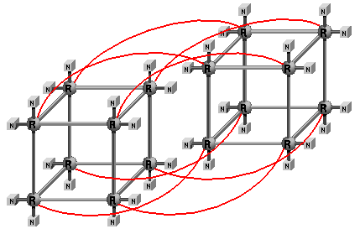
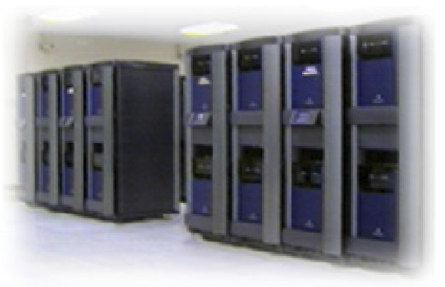
SGI Origin 2000
Scalable shared memory multiprocessor
MIPS R10000 CPU
NUMAlink router
Directory-based cache coherency (MESI)
ASCI Blue Mountain

Slide 32
Next Topics
Parallel Program Design and Multithreading in Shared Memory Architectures
Distributed Computing and Distributed Memory Models

